Slide 1
LSHRM BOARD ORIENTATION
Presented by:
Susan Huffmon, SHRM-CP, PHR
2018 President Elect
Notes:
Before we go through the slide deck for the orientation, I would like to ask if anyone has anything in particular that they want get from this orientation that I can put on the flip chart to make sure we cover?

Slide 2
AGENDA
5:45 – 6:15 Welcome and Dinner
6:15 – 7:00 Orientation
7:00 – 7:45 Assessment Types
7:45 – 8:45 Budget and Goal Setting

Slide 3
Background of LSHRM
Founded in 1940 - The Louisville Personnel Association
In 1992 the name was changed to The Louisville Society for Human Resource Management (LSHRM)
Among 575 Chapters with the Society For Human Resource Management (SHRM)
LSHRM is committed to excellence in the practice of human resource management and is Kentucky's largest professional human resources organization with more than 580 members
LSHRM Awards
SHRM Foundation Champion (2014, 2016, 2017)
SHRM Excel Platinum Chapter (Workforce Development)
Notes:
LSHRM was founded in 1940 and was called the Louisville Personnel Association. We have almost 600 members
We are among the 575 Chapters with the Society for Human Resource Management (SHRM) within the United States.
SHRM represents over 300,000 members in more that 165 countries.
We have been awarded the SHRM Foundation Champion award for 3 years. In 2017 we were the 3rd in the nation for raising dollars for the SHRM Foundation.
LSHRM was presented with the Excel Platinum Award for our work around Workforce Development

Slide 4
Our Purpose and Meaning
To serve the community as a business partner that creates bold and innovative workforce solutions.
Notes:
In 2017 our team met to have a strategy planning meeting. The board came up with our purpose and meaning.
Our Purpose and Meaning is what we want to think about when we are making decisions and moving the Chapter forward.
You each will have a copy of LSHRM’s Playbook in your handouts for reference.

Slide 5
Our Beliefs
We believe serving the community promotes positive change.
We believe our impact goes beyond the HR professional.
We believe that in business, PEOPLE matter most.
We believe innovation drives business solutions.
We believe LSHRM can be the catalyst for advancing the Kentuckiana workforce.
Notes:
During this meeting we also came up with our Beliefs. What are the things that we as a chapter believe in.

Slide 6
Our Success Formula
IT’S ALL ABOUT P.E.O.P.L.E!
P artner and share best practices
E ngage new and existing membership and our volunteer base
O ffer creative and disruptive programming (digital and in-person)
P romote LSHRM brand through creative and consistent marketing
L ead effort in building a stronger economy
E mpower HR professionals to be strategic business partners
Notes:
Our success formula is “How we will achieve our ambitions and deliver on our purpose.”
These are the things that we as a board should constantly be working on – We may have our individual roles/responsibilities that we work toward but we should all be focused on PEOPLE. Think about your team and how you and your team can add to each of these. For example: The Volunteer engagement team can really relate to the E in people. Think about how you can engage new and existing members and recruit new members. The programming team can really relate to the O in people by creating disruptive programs for the chapter. We should all be thinking of “People” and how we can move the chapter forward by doing these things.

Slide 7
Our Behaviors
The 5 C’s
Be Committed
Passionately engage to deliver on your expected outcomes and our shared purpose
Be Creative & Collaborative
Accept diverse points of view and work together to develop bold, innovative solutions
Be Current
Stay on top of industry trends and the changing HR landscape so that we can be informed experts
Be Change Agents
Make a difference by responding to changes in the community and offering solutions
Notes:
Our Behaviors:
We as a board should be committed. Not only to what is listed on the slide, but also committed to being engaged and attending meetings.
Creative and Collaborative – Be open to different points of view and create solutions to a variety of
Current – All of us should strive to keep up with the latest and greatest in Human Resources so that we can educate our members
Change Agents – When changes happen in the community that relate to HR, we should be the consulting force that the community relies on to help through the changes.

Slide 8
Benefits of volunteering with LSHRM
Attend monthly educational meetings at the member rate | Advertise your organization’s HR openings at no cost
Earn SHRM Certification and HRCI Credits | Job/career transition support group
SHRM Certification preparation study groups for FREE | Attend internship management workshops and student opportunities
Networking opportunities | Attend other special LSHRM events at the member rate
Community volunteer opportunities | Mentor and mentee opportunities
Leverage a virtual resume coach at no cost for those in transition or seeking new opportunities | Alignment and partnership with the national SHRM Foundation
Leadership and teamwork opportunities via board appointments or committee participation | IT’S FUN!
Access to on-line professional development content
Notes:
So now that we’ve gone through our purpose, beliefs and behaviors we will move on to the benefits of volunteering with LSHRM.

Slide 9
What is required of a LSHRM Board Member
Maintain an LSHRM and national SHRM membership while serving on the board.
Know and understand the LSHRM bylaws.
Be an active board member:
Attend chapter meetings and board meetings. If you cannot attend at least 8 board meetings, you might consider a role outside of a Director. It is imperative that Directors and above attend board meetings because we have to have a quorum to vote on important LSHRM business initiatives.
Attend one Saturday planning meeting in September or October
Be prepared to report your committee’s progress and achievements at board meetings. (These meetings are so important for leaders of LSHRM. If you cannot attend, please designate someone to attend in your place or ask someone to report for you.)
Develop annual goals for your committee and share them with your team and the board.
Participate in carrying out your committees goals.
Work within your budget and let Finance know of any changes or new initiatives
Ask critical questions, and help the board come to agreement in making decisions that affect chapter membership.
Notes:
LSHRM is a business and we want to run our chapter as an efficient business.
In order to be on the board of directors there are a few very important commitments we want to ask of you as leaders of the Chapter that will help our chapter tremendously.
We need board members, Directors and above to be at all board meetings. If you must miss a meeting, we need you to have someone from your team to attend and report in on your initiatives and goals. We also need directors and above at the meeting so that they can vote on pressing business initiatives.
We also have one planning meeting annually in late September or October that our board members, directors and above must attend on a Saturday so that we can prepare for the upcoming year. Strategy Meeting
We also ask that you make at least a $25 donation to the LSHRM Foundation – You can give by check or a gift card to go into various drawings or the Silent Auction each year
Emails to President, President Elect and the VP of Administration: Always copy on email correspondence. This allows the incoming president elect and vice president to be aware of things going on within all of your groups so that they can assist the President.
Responding to emails within 24-48 hours – let people know if you don’t have an answer

Slide 10
Lead your committee:
Manage, direct & support your committee.
Develop your leadership skills.
Recruit and fill your committee positions.
Succession plan for your committee.
Communicate information
Oversee your committees budget:
Develop committee annual budget.
Operate responsibly within that budget.
Track and report expenses.

Slide 11
Always copy President, President Elect and VP, Administration on email correspondence.
Return emails and or phone calls within 24 - 48 hours.
If you commit to having something in by a certain date, please let others know if you will not be able to meet your deadlines so preparation can be made if needed.

Slide 12
Board Meetings
Prepare a written report prior to each board meeting
Disseminated and reviewed prior to the meeting
We use time at meetings to discuss pressing HR issues or work on projects
Consent items are approved at our meetings in a batch format
Voting – Directors and above make the motions to vote on consent items, and close the meetings

Slide 13
SHRM Volunteer Structure
(NETWORK OF CHAPTERS, STATE & REGIONAL COUNCILS & MAC)
SHRM Board of Directors
Membership Advisory Council
Staff Leadership / Support
Interface between volunteer leaders and SHRM Board
One elected representative from each of the five Regions
Special Expertise Panels
Members identify emerging trends in specific topic areas
Provide expert advice on matters of professional significance
Provide guidance on public policy issues
Be on the cutting edge through access to early information on emerging trends and issues:
Ethics/CSR
Global
Technology & HR Management
Labor Relations
Talent Acquisition
Diversity & Inclusion
HR Disciplines :
Organizational Development
Compensation
Benefits
Employee Health, Safety & Security
Employee Relations
Regional Councils
Five councils comprised of state council directors in each region
Provides channels of communication
Serves as liaison with business leaders and SHRM
State Councils
Structure for key volunteer leaders in the state to adopt and promote SHRM initiatives
Channel of communication between chapters and regional councils
Serves all HR professionals in the state, by promoting chapter membership and local professional development
MEMBERS
Local Chapters
Forum for personal and professional development
Opportunity for local members to develop leadership skills
Focus on current HR management issues
Entry point for introducing HR professionals to SHRM

Slide 14
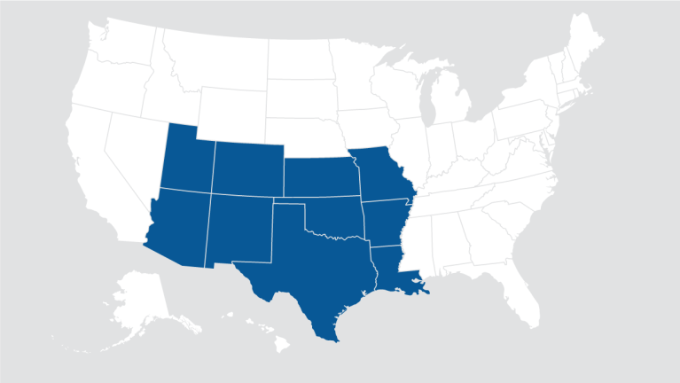
Regional Structure – Professional Chapters
66
144
North East
91
Pacific West
North Central
108
154
Southwest
Central
South East

Slide 15
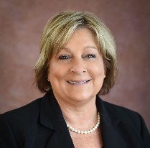
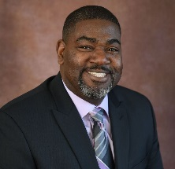
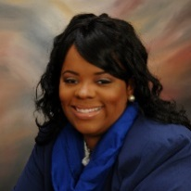
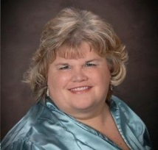
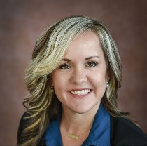
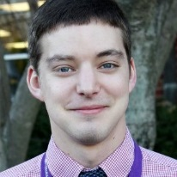
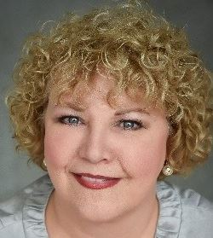
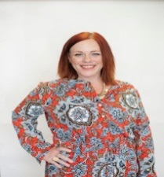
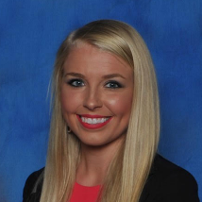
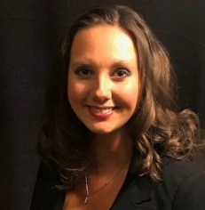
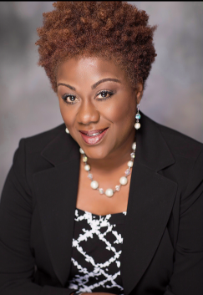
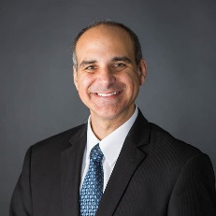
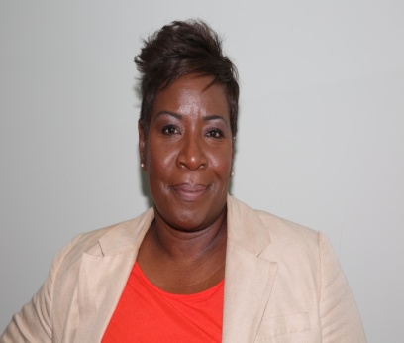
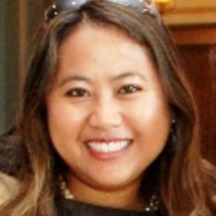
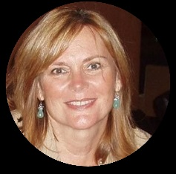
2019 LSHRM Board
Susan Huffmon, PHR, SHRM-CP President
Rawleigh Richardson, Sr.,
MAHRM, PHR, SHRM-CP
President-Elect
Patricia Williams, SHRM-CP, CSP Immediate Past President
Kelly Groves VP, Chapter Administration
Janessa Moran, SHRM-CP VP, Finance
Joshua Williams Director of Workforce Readiness
Shelly Trent Director of Programs
Amy Olds Director, Member Development
and Certification
OPEN
Kayla Holzknecht Director, Hospitality
Director of Communications
and Marketing
Kin Ratliffe Director, Membership
Pamela Williams Director, SHRM Foundation
and Special Events
Sam Mannino Director, Community
and College Relations
Aretha Williams
Director, Volunteer Engagement
Tiffany Cardwell Director of Wellness Initiatives
Debbie Fisher, Director of Compensation
Notes:
Short Bios – Name – where your work – degree’s, certifications -

Slide 16
Chapter Leadership Responsibilities
President | President Elect | Immediate Past President | VP, Chapter Administration
Provides leadership to the local chapter consistent with state, regional, and SHRM policy, strategies and objectives. Effectively operate the chapter so that the needs of the members are met. Performs other duties as required by the local chapter's bylaws. Serves as a voting member of the state council. | Assists the president in overseeing all the activities of the chapter. In the absence of the president, perform all the presidential responsibilities. | Advises the president and other officers and members of the board of directors regarding past practices, general operations, and other matters to assist in the smooth operation of the chapter. | Takes minutes of chapter meetings, provides notice of meetings and general correspondence. Maintains chapter records and history.
Notes:
Review the job descriptions in your packet.

Slide 17
Leadership Responsibilities
VP, Finance | Director, Workforce Readiness | Director, Programs | Director, Member Development & Certification
Acts as financial officer and advisor to chapter board of directors. Maintains the chapter mailbox and distributes mail to the appropriate officer, director, or chair. Sends dues notices and other invoices to members. Files appropriate forms and information with IRS. | Monitors and evaluates on a continuing basis local activities concerning workforce readiness issues and plans and encourages chapter involvement and activities impacting the workforce readiness arena. Presents a report or update to the chapter president and fellow chapter members. Works in cooperation with state-level workforce readiness advocates. Generally has 5-6 chairs and co-chairs | Manages the activities of the conference committee to provide conference programs for the chapter membership. Generally has 7-8 chairs and co-chairs | Manages the activities of the professional development committee to provide seminars, workshops and other professional development opportunities for the chapter membership. Generally has 2 co-chairs

Slide 18
Leadership Responsibilities
Director, Hospitality | Director, Communications and Marketing | Director, Membership | Director, SHRM Foundation and Special Events
Welcomes new members into the chapter and helps coordinate the logistics of monthly membership meetings. Generally has 1-2 co-chairs | Manages the social media communications and marketing of chapter events, the website administration and newsletter publications. Generally has 5-6 chairs and co-chairs | Manages the membership function to successfully achieve an increase in chapter membership. Generally has 2-3 co-chairs | Educates, promotes, and represents the interests of the SHRM Foundation and its activities to the chapter membership. Manages the special HR Connects for chapter Manages Best Places To Work for Chapter Generally has 5-6 chairs and co-chairs

Slide 19
Leadership Responsibilities
Director, Community and College Relations | Director, Volunteer Engagement | Director, Wellness Initiatives | Director, Compensation
Manages the scholarship program, internship program, and college outreach efforts. Generally has 3-4 co-chairs | Manages the process of recruiting and retaining volunteers for the chapter. Manages the monthly SPOT Award for members Manages engagement opportunities for the chapter board and volunteers Generally has 1 chair | Manages the wellness activities of the chapter and provides opportunities to participate in wellness related events. Generally has 2-3 co-chairs | Manages the relationship with World at Work regarding compensation and provides the chapter with updates on Compensation related topics. Generally has 1 chair

Slide 20
Budgets and Expenses
Each Director has a budget they are responsible for:
Set budget in October or November with Finance Director and Chair
If you know you will need extra money for an initiative, let the Finance area know
Review budget documents monthly to make sure everything looks complete
Ask questions if something doesn’t look right on your budget
Expenses
All expenses must be approved in advance by the LSHRM President if not in budgets
If you incur out of pocket expenses for some reason, please complete an expense form and turn into the Finance Director for reimbursement

Slide 21
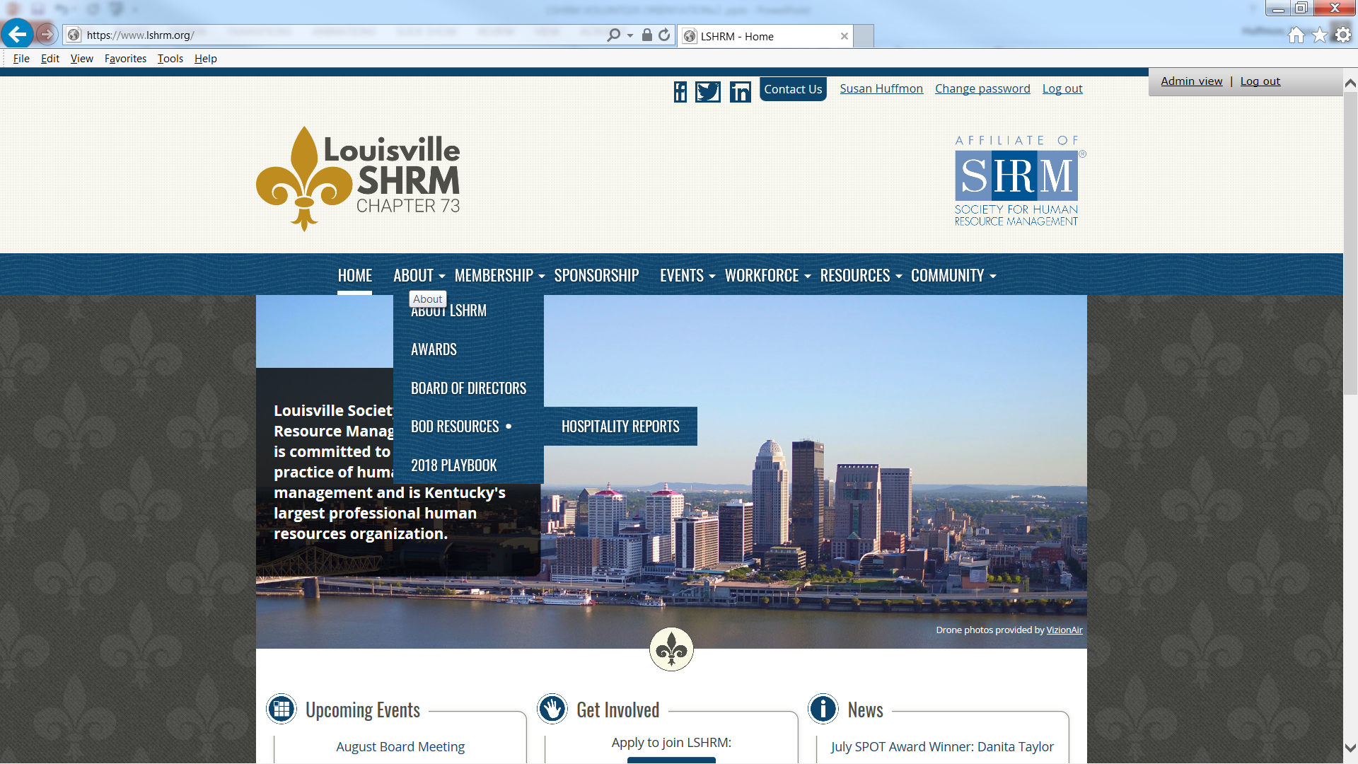
Website Resource
Notes:
Another good resource for new board members is the BOD Resources page.

Slide 22
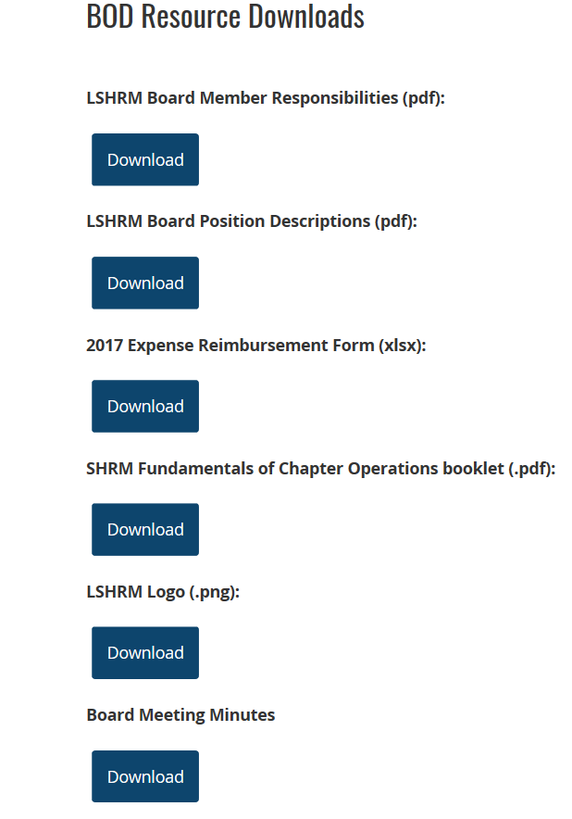
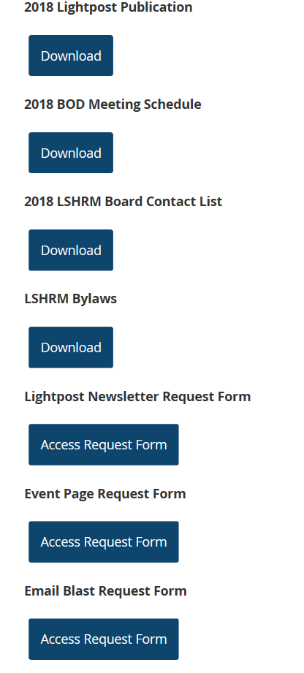
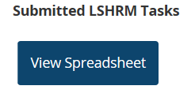
BOD Resources Page
Notes:
As you can see there are many resources for you to use and review. (GO OVER MAIN BUTTONS and explain how you submit for email blasts events etc.

Slide 23
Other Resources
Volunteer Leader Resource Center (VLRC)
https://community.shrm.org/vlrc/home?_ga=2.179321956.1756533811.1522684374-1676516191.1522684374
LSHRM Website
https://www.lshrm.org/
https://www.lshrm.org/HR-Links

Slide 24
QUESTIONS?

Slide 25
Handouts: (Have them bound) Job Descriptions Board Contact List 2019 Meeting Dates List LSHRM BYLAWS Playbook Personality Types Myers Briggs PP Goal Setting PP
Resources for Orientation

